Slide 1
AWT in Java
AWT :
AWT (Abstract Window Toolkit) represents a class library to develop applications using GUI.
java.awt package contains all classes used for creating
GUI, painting graphics, images, colors and fonts.
A user interface element such as a button is called a Component. The Component class is the super class of all
AWT components. These components fire events when users interact with these components

Slide 2
AWT in Java
AWT :
A Container is one which contains components and other
containers. A container has a layout manager that
determines the visual placement of components in the
container

Slide 3
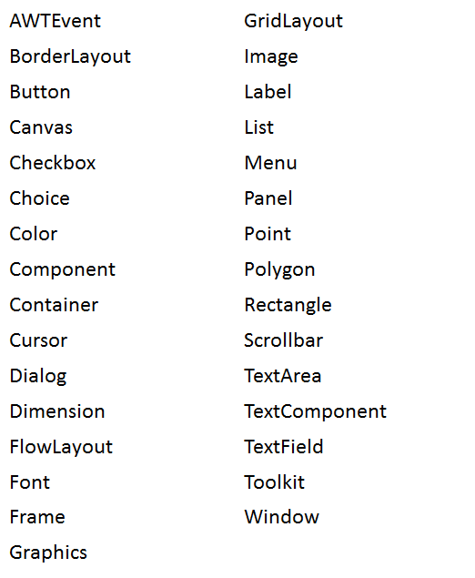
AWT in Java
Commonly used AWT Classes :

Slide 4
AWT in Java
AWT Controls :
AWT supports the following types of controls:
Label
Button
Checkbox
RadioButton
Choice
List
TextComponent
ScrollBar

Slide 5
AWT in Java
AWT Controls :
Adding/Removing Controls :
Component add (Component compObj)
void remove(Component compObj)
HeadlessException:
The constructors of AWT controls can throw a HeadlessException when an attempt is made
to instantiate a GUI component in a non-interactive
environment

Slide 6
AWT in Java
Label :
It contains a string, which is a passive control that doesn’t
support any user interaction
Label()
Label(String str)
Label(String str, int align)
align may be Label.LEFT or Label.RIGHT or Label.CENTER
Label lbl=new Label("Hello");
lbl.setText (“New Text”);
String txt=lbl.getText();
lbl.setAlignment(Label.RIGHT);int algn=lbl.getAlignment();

Slide 7
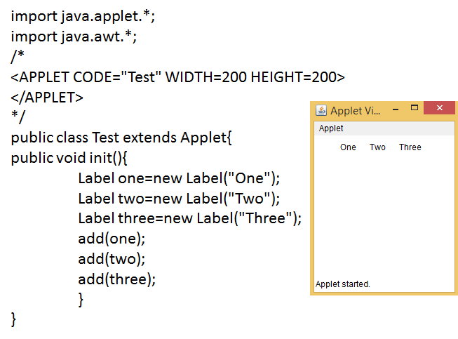
AWT in Java
Label :

Slide 8
AWT in Java
Button :
It is a component that contains a label and that generates
an event when it is pressed.
Button()
Button(String str)
Button btn=new Button("Hello");
btn.setLabel(“New Text”);
String txt=btn.getLabel();

Slide 9
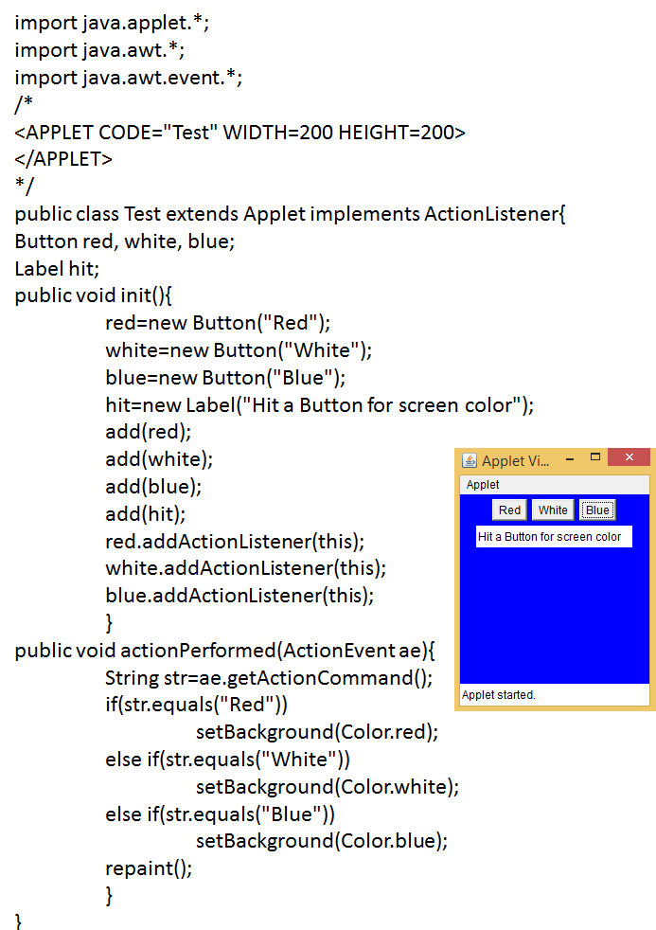
AWT in Java
Button :

Slide 10
AWT in Java
Checkbox :
It is used to turn an option on or off
Checkbox()
Checkbox(String str)
Checkbox(String str, boolean state)
Checkbox name=new Checkbox(Names", null, false);
boolean st=name.getState();
name.setState(boolean state);
String str=name.getLabel();
name.setLabel(“New Text”);

Slide 11
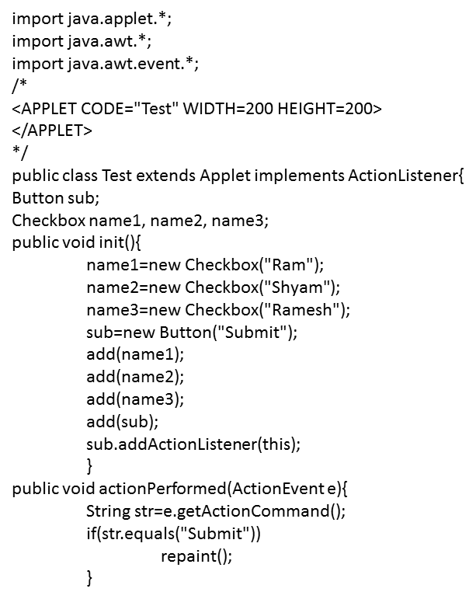
AWT in Java
Checkbox :

Slide 12
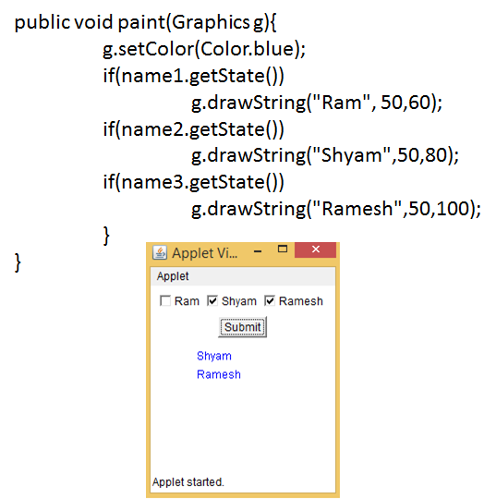
AWT in Java
Checkbox :

Slide 13
AWT in Java
Radio Button :
These are a special kind of checkboxes. CheckboxGroup
class is used to group together a set of checkboxes
CheckboxGroup fruits=new CheckboxGroup();
add(new Checkbox(Mango",fruits, false);
add(new Checkbox(Äpple",fruits,false);

Slide 14
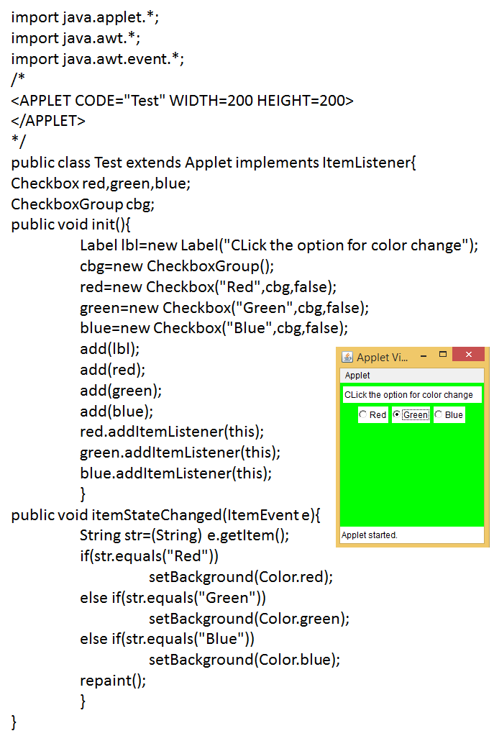
AWT in Java
Radio Button :

Slide 15
AWT in Java
TextField :
It handles single line of text
_x000F_ TextField()
TextField(int noChars)
TextField(String str)
TextField(String str, int noChars)
_x000F_ String getText()
void setText(String str)
_x000F_ String getSelectedText()
void select(int startIndex, int endIndex)
_x000F_ boolean isEditable()
void setEditable(boolean isedit)
_x000F_ void setEchoChar(char ch)

Slide 16
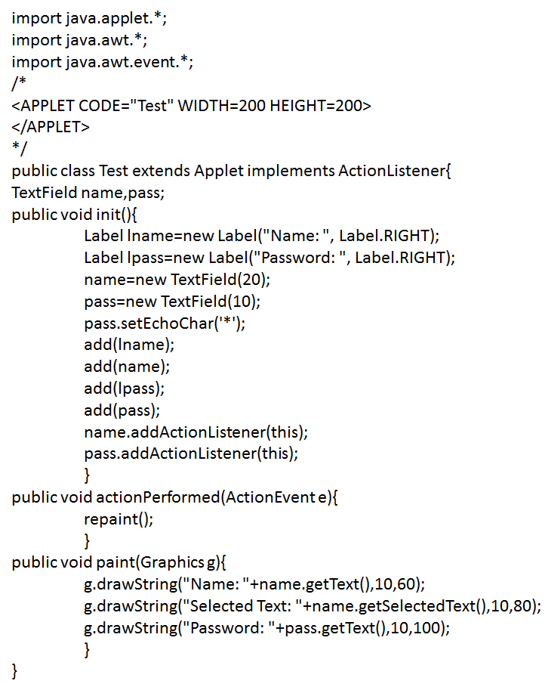
AWT in Java
TextField :

